Slide 1
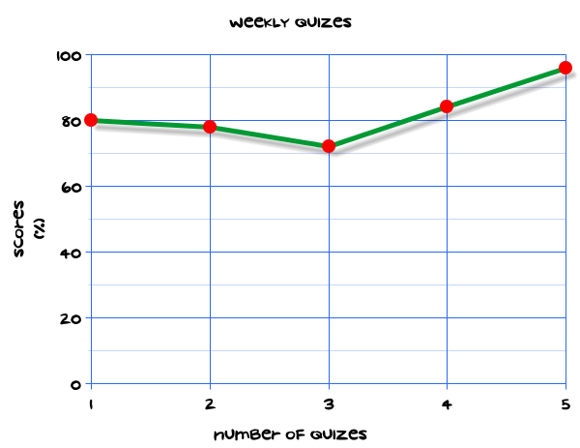
My Statistics Interactive Notebook
Name
Class
Teacher
Term 1 Semester 1
1

Slide 2
Create your own front page
It needs to contain the following –
My number interactive notebook
Name
Class
Teachers Name
Semester 1 Term 1
Page number 1

Slide 3
Contents
Glossary or Formula Page
Page
Date
Description
2
3

Slide 4
Tasks
24
7
30
Essential Question
Questions
Notes
Summary
4
5

Slide 5
24
7
30
Date
Title
EQ –

Slide 6
24
7
30
Date
Complementary events
EQ – How do I calculate the probability of complementary events?

Slide 7
24
7
30
Date
Complementary events
EQ – How do I calculate the probability of complementary events?
What does complement mean in probability?
The complement of an event is written as E’.
E’ is the event that E does not occur

Slide 8
24
7
30
Date
Complementary events
EQ – How do I calculate the probability of complementary events?
What does complement mean in probability?
The complement of an event is written as E’.
E’ is the event that E does not occur
(Write this explanation into your glossary on page 3)

Slide 9
24
7
30
Date
Complementary events
EQ – How do I calculate the probability of complementary events?
What does complement mean in probability?
The complement of an event is written as E’.
E’ is the event that E does not occur
(Write this explanation into your glossary on page 3)
Example:
Pr(3’) = Pr( not getting a 3)
The complement of rolling a 3 is: not rolling a 3

Slide 10
24
7
30
Date
Complementary events
EQ – How do I calculate the probability of complementary events?
What does complement mean in probability?
The complement of an event is written as E’.
E’ is the event that E does not occur
(Write this explanation into your glossary on page 3)
Example:
Pr(3’) = Pr( not getting a 3)
What does the probability of an event and its complement add up to?
The complement of rolling a 3 is: not rolling a 3
$$\operatorname{Pr}\left(E\right)+\operatorname{Pr}\left(E^{′}\right)=1$$

Slide 11
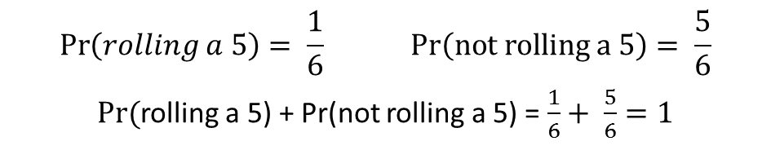
24
7
30
Date
Complementary events
EQ – How do I calculate the probability of complementary events?
What does complement mean in probability?
The complement of an event is written as E’.
E’ is the event that E does not occur
(Write this explanation into your glossary on page 3)
Example:
Pr(3’) = Pr( not getting a 3)
What does the probability of an event and its complement add up to?
The complement of rolling a 3 is: not rolling a 3
$$\operatorname{Pr}\left(E\right)+\operatorname{Pr}\left(E^{′}\right)=1$$
Example:
$$\operatorname{Pr}\left(rolling a 5\right)= \frac{1}{6} Pr\left(not rolling a 5\right)= \frac{5}{6}$$
$Pr⁡($rolling a 5) + Pr(not rolling a 5) = $\frac{1}{6}+ \frac{5}{6}=1$

Slide 12
24
7
30
Date
Complementary events
EQ – How do I calculate the probability of complementary events?
What does complement mean in probability?
The complement of an event is written as E’.
E’ is the event that E does not occur
(Write this explanation into your glossary on page 3)
Example:
Pr(3’) = Pr( not getting a 3)
What does the probability of an event and its complement add up to?
The complement of rolling a 3 is: not rolling a 3
$$\operatorname{Pr}\left(E\right)+\operatorname{Pr}\left(E^{′}\right)=1$$
Example:
$$\operatorname{Pr}\left(rolling a 5\right)= \frac{1}{6} Pr\left(not rolling a 5\right)= \frac{5}{6}$$
$Pr⁡($rolling a 5) + Pr(not rolling a 5) = $\frac{1}{6}+ \frac{5}{6}=1$
How do I use this?
If $\operatorname{Pr}\left(red\right)= \frac{2}{7} then\operatorname{Pr}\left(not red\right)= \frac{5}{7}$

Slide 13
24
7
30
Date
Complementary events
EQ – How do I calculate the probability of complementary events?
What does complement mean in probability?
The complement of an event is written as E’.
E’ is the event that E does not occur
(Write this explanation into your glossary on page 3)
Example:
Pr(3’) = Pr( not getting a 3)
What does the probability of an event and its complement add up to?
The complement of rolling a 3 is: not rolling a 3
$$\operatorname{Pr}\left(E\right)+\operatorname{Pr}\left(E^{′}\right)=1$$
Example:
$$\operatorname{Pr}\left(rolling a 5\right)= \frac{1}{6} Pr\left(not rolling a 5\right)= \frac{5}{6}$$
$Pr⁡($rolling a 5) + Pr(not rolling a 5) = $\frac{1}{6}+ \frac{5}{6}=1$
How do I use this?
If $\operatorname{Pr}\left(red\right)= \frac{2}{7} then\operatorname{Pr}\left(not red\right)= \frac{5}{7}$
If Pr(red) = 0.3 then Pr(red’) = 0.7
If Pr(red) = 30% then Pr(red’) = 70%

Slide 14
Task
Go on Connect on your iPad. Find the notes for today and click on the following link.
complement quiz
Extension:
Ask your teacher for the extension questions.

Slide 15
Notes Review
24, 7 ,30
Date
Title
Essential question
Notes complete
Notes complete with colour and diagrams
Questions completed
Contents page filled in
Formula page filled in

Slide 16
Homework
Review your notes and write a summary answering the essential question.

